Slide 1
NUMERICAL METHODS CSE - 311

Slide 2
NUMERICAL METHODS, NM (CHAPRA-3)
An approach for solving complex mathematical problems using simple arithmetic operations
Involves formulation of mathematical models of physical situations
Requires development, analysis and use of algorithm
Thus, NM can be defined as techniques by which math problems are formulated for essential features / behavior of a physical system , so that they can be solved with arithmetic operations
A problem even if, can not be solved by analytical analysis, we can solve it by numerical analysis
Analytical analysis - provides accurate soln
Numerical analysis - error exists

Slide 3
NUMERICAL METHODS, NM (CHAPRA-3)
Analytical soln can be derived for limited class of problems only which include linear models, those who have simple geometry and low dimensionality. But most of the real problems are non-linear and involve complex shape and process

Slide 4
NUMERICAL METHODS AND ENGG PRACTICE (CHAPRA- 4)
Since late 1940s , the widespread availability of digital computers has led to a veritable (true) explosion in the use and development of numerical methods
Most Engg problem solving employs two-pronged approach
Theoretical
Empiricism (experimentally)

Slide 5
NUMERICAL PROBLEM SOLVING PROCESS (BALAGURUSAMY- 3)
Formulation of a mathematical model
Construction of an appropriate numerical method
Implementation of the method to obtain a solution
Validation of the solution
Modeling is the process of translating a physical problem into a mathematical one
Mathematical model can be defined as formulation of certain equations that express the essential features of a physical system or process in mathematical term. May be represented as:
Dependent Variable=f (independent variable, parameter, forcing function)
Formulation of mathematical model begins with a “Statement of the Problem” and then associated factors are considered

Slide 6
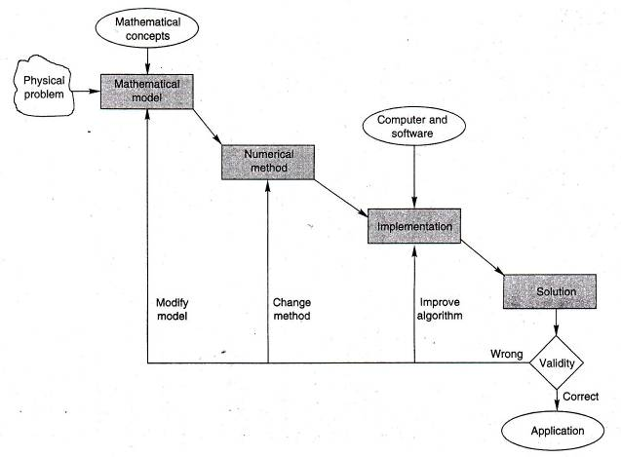
ENGG / NUMERICAL PROBLEM SOLVING PROCESS (BALAGURUSAMY- 3)

Slide 7
FEW REASONS TO STUDY NUMERICAL METHODS (CHAPRA- 5)
Extremely powerful problem solving tool (can handle large system of eqn, non-linearities and complicated geometries)
Commercially available prepackaged computer programs can be easily used
Many problems cannot be approached using canned (pre-recorded) programs (if adept at computer programming, one can design and develop own program to solve problems)
Efficient vehicle for learning computers (an effective way to learn computer is to write computer program)
Provide a vehicle to reinforce understanding of mathematics (one of the function of NM is to reduce higher math to basic arithmetic operation)

Slide 8
SCOPE OF NUMERICAL METHOD
NM usually deal with following
Find roots of equation (values of a variable that satisfy single non-linear eqn)
Solving systems of linear algebraic equations ( set of values that simultaneously satisfy a set of linear eqn)
Optimization (involves identifying maxima or minima. It determines values of an independent variable that corresponds to a best or optimum value of a function)
Curve fitting (regression and interpolation - regression derives a single curve that represent general trend of the data without matching any individual points, interpolation determines intermediate values between relatively error free data points)
Numerical integration ( determination of area under a curve, even the centroids of an oddly shaped objects)
Solutions of differential equations (rate of change of a quantity w.r.t. two/more variables)
Ordinary Differential Equations (ODE)
Partial Differential Equation (PDE)
Solution of matrix problems

Slide 9
ERRORS IN NUMERICAL METHOD
Numerical errors arise from the use of approximation to represent exact mathematical operations and quantities
Major form of numerical errors: (Chapra- 51)
Truncation error
Round-off error
Algorithmic

Slide 10
how error is introduced
Mistake made while entering/computing numbers
Improper numerical method
Approximations, e.g. round-off, truncation
Limitations of the mechanical devices (e.g. calculator, computer) used in computations
Information is being lost due to shift or truncation
When the difference of two almost equal numbers is calculated

Slide 11
TRUNCATION ERROR (CHAPRA- 51)
Truncation error is the discrepancy introduced by the fact that numerical methods may employ approximations to represent exact mathematical operations and quantities
Truncation error are those that result from using an approximation in place of an exact mathematical procedure
If a number has too many digits, it is inconvenient or even impossible to feed / store it in computer’s memory
After some digits, the remaining digits are chopped off
For example, 46.237533 => 46.23
Error due to chopping off is “Truncation Error”

Slide 12
ROUND-OFF ERROR (CHAPRA- 51)
Round-off errors originate from the fact that computers can represent quantities only with a finite number of digits
Computers retain only a fixed number of significant figures /digits during a calculation. Omission of the remaining significant figures is called round-off error
Numbers such as π, e can not be expressed by a fixed number of significant figures /digits
In addition, because computers use base -2 representation, they cannot precisely represent certain exact base -10 numbers

Slide 13
Round-off error
When a number has inconvenient digits, rounding-off is better than truncation
Last retained digit is adjusted depending on succeeding digit
If the succeeding digit < 5, the last retained digit is unchanged. For example, 2.365432 is rounded off to 2.365 (correct to three decimal places)
If the succeeding digit >= 5, the last retained digit is increased by 1. For example, 0.123604 is rounded off to 0.124 (correct to three decimal places)

Slide 14
algorithmic error
Errors are caused by a wrong choice of algorithm
Algorithm may be mathematically perfect, but the computations can cause errors due to truncation and rounding-off
Sometimes, an algorithm gets stuck up in an intermediate step since the numbers at that step are too small / large with compared to the range of the device

Slide 15
TOTAL NUMERICAL ERROR (CHAPRA- 93)
Total numerical error = round-off error + truncation error
Round-off error can be minimized by increasing the number of significant digit
Round-off error will increase due to an increase in number of computations
Truncation error can be reduced by decreasing the step size, but this leads to an increase in computations
So the dilemma is, the strategy for decreasing one component of the total error leads to an increase of the other component

Slide 16
TOTAL NUMERICAL ERROR (CHAPRA- 93)
We could conceivably decrease the step size to minimize truncation errors only to discover that in doing so, round off begins to dominate the solutions and the total error grows
We will choose a large step size in order to decrease the amount of calculations thus, Round-off errors without incurring the penalty of a large truncation error
If the total error is shown in figure, the challenge is to find the point of diminishing returns where round-off error begins to negate the benefits of step size reduction

Slide 17
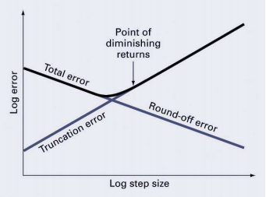
TOTAL NUMERICAL ERROR (CHAPRA- 93)

Slide 18
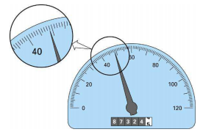
SIGNIFICANT FIGURES (CHAPRA- 51)
The significant figures or digits of a number are those that can be used with confidence
Developed to formally designate the reliability of a numerical value

Slide 19
SIGNIFICANT FIGURES (CHAPRA- 51)
In case of the speedometer, one person might say 48.8 whereas another might say 48.9 km/h
Because of the limits of the instrument, only the first two digits can be used with confidence
The odometer, on the other hand, provides up to six certain digits
From figure we can say, the car has traveled slightly less than 87324.5 km during its lifetime

Slide 20
SIGNIFICANT FIGURES (CHAPRA- 51)
The following statements describe the notion of significant digits
All non-zero digits are significant
All zeros occurring between non-zero digits are significant
Trailing zeros following the decimal point are significant. For example 3.50, 65.0 and 0.230 have three significant digits each

Slide 21

SIGNIFICANT FIGURES (CHAPRA- 51)
Zeroes between the decimal point and
preceding a non-zero digit are not significant. For example, the following numbers have four significant digits

Slide 22
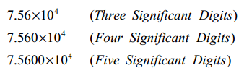
SIGNIFICANT FIGURES (CHAPRA- 51)

Slide 23
FINITE NUMBER OF QUANTITIES (CHAPRA- 63)
The errors introduced by approximating numbers
within the range is called Quantizing error. It can occur in two ways:
Chopping
Rounding
In chopping, extra digits are dropped. In a computer with a wordlength of 4, a number like 42.7893 will be stored as 42.78 and the digits 93 will be dropped
In rounding, the last retained significant digit is rounded up by 1 if the first discarded digit is larger than or equal to 5; otherwise, the last retained digit is unchanged.

Slide 24
ACCURACY AND PRECISION (CHAPRA- 53)
Accuracy (opposite - inaccuracy) refers to how closely a computed or measured value agrees with the true value
Precision (opposite - imprecision) refers to how closely individual computed or measured values agree with each other
Inaccuracy (bias) is defined as systematic deviation from the truth
Imprecision (uncertainty) refers to the magnitude of the scatter

Slide 25
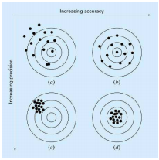
ACCURACY AND PRECISION (CHAPRA- 53)

Slide 26
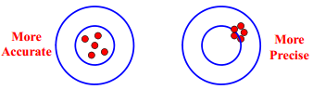
ACCURACY AND PRECISION (CHAPRA- 53)
Accuracy is getting all shots near the bull’s eye of target
Precision is getting them close together
A NM should be sufficiently accurate/unbiased to meet the requirement of a particular Engg problem

Slide 27
ACCURACY AND PRECISION (CHAPRA- 53)
Accuracy refers to number of significant digits in a value. For example, the number 57.396 is accurate to five significant digits
Precision refers to the number of decimal positions i,e. order of magnitude of the last digit in a value. For example, the number 57.396 has a precision of 0.001
Homework: Example 4.1& 4.2 (Balagurusamy-63)

Slide 29
Way to account for magnitude of the quantity being evaluated is to normalize the error to the true value
For NM, the true value will be known only when we deal with functions that can be solved analytically
In real world applications, we will obviously not know the true value in a priori
Homework: Example-3.1 (Chapra)

Slide 30
An alternative is to “Normalize the error” using best available estimate of the true value
Certain numerical methods use an iterative approach to compute answers
In such an approach, a present approximation is made on the basis of a previous approximation

Slide 32
COMPUTER representation of numbers
Arithmetic operations
Integer arithmetic
Real or floating point arithmetic
Computer does not store real numbers
Each location (word) stores finite number of digits
Word--fundamental unit by which information is represented
Word is an entity that consists of a “string of binary digits or bits”
Numbers are typically stored in one or more words

Slide 33

COMPUTER REPRESENTATION OF INTEGER NUMBERS (CHAPRA- 59)
Signed-Magnitude Method: First bit of a word indicate the sign, with a 0 for positive and a 1 for negative
Remaining bits are used to store the number
For example, the integer value of -173 on a 16-bit computer

Slide 34

COMPUTER REPRESENTATION OF FLOATING-POINT NUMBERS (CHAPRA- 60)

Slide 35
COMPUTER REPRESENTATION OF FLOATING-POINT NUMBERS (CHAPRA- 60)

Slide 36
COMPUTER REPRESENTATION OF FLOATING-POINT NUMBERS (CHAPRA- 60)
Advantage:
It allows both fractions and very large numbers to be expressed on the computer
Disadvantage:
It takes up more room and take longer to process than integer representation
It introduces a source of error (round- off) because the mantissa holds only a finite number of significant figures

Slide 37

binary to decimal
Consider the binary number 101.011
Calculate the decimal value of it.

Slide 38
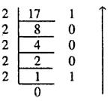

decimal to binary
Convert decimal 17.375 to binary
17.375 = 10001.011 (binary)

Slide 39
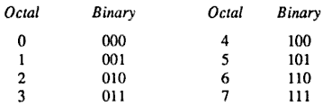
Octal Number System
8-base number system
8 symbols (0, 1, 2, 3, 4, 5, 6, 7)
Base/radix is power of 2
One-to-one relation between octal and binary
A binary number could be converted easily to octal
Group 3 bits and convert directly to octal

Slide 40
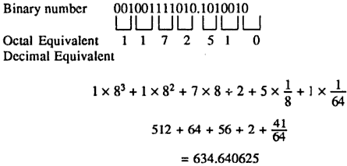
binary to octal to decimal
Instead of converting binary to decimal, faster process is binary to octal to decimal

Slide 41
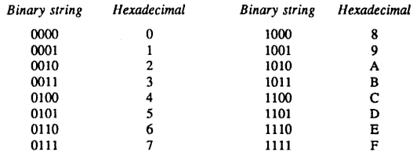
hexadecimal
16-base number system
16 symbols (0—9, A, B, C, D, E)
Again radix is power of 2
4 bits to represent a hexadecimal number

Slide 42
Thank You All …
Questions
??

